Slide 1
Robots – Theory
Arduino

Slide 2
Arduino
Arduino is an open-source electronics platform based on easy-to-use hardware and software.
Arduino was born at the Ivrea Interaction Design Institute as an easy tool for fast prototyping, aimed at students without a background in electronics and programming. As soon as it reached a wider community, the Arduino board started changing to adapt to new needs and challenges, differentiating its offer from simple 8-bit boards to products for IoT applications, wearable, 3D printing, and embedded environments.

Slide 3
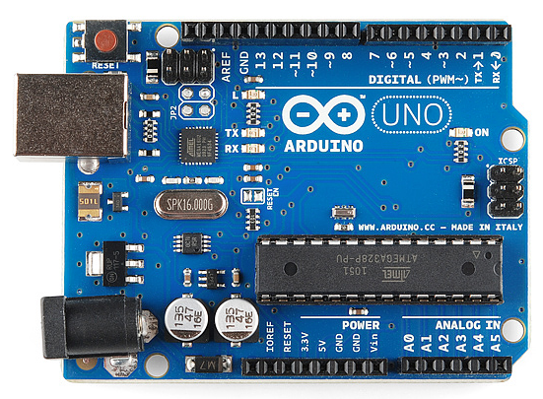
Arduino
The Arduino software is easy-to-use for beginners, yet flexible enough for advanced users. It runs on Mac, Windows, and Linux.

Slide 4
Arduino Hardware and Software
Arduino boards are generally based on microcontrollers from Atmel Corporation like 8, 16 or 32 bit AVR architecture based microcontrollers.
The important feature of the Arduino boards is the standard connectors. Using these connectors, we can connect the Arduino board to other devices like LEDs or add-on modules called Shields.
The Arduino boards also consists of on board voltage regulator and crystal oscillator. They also consist of USB to serial adapter using which the Arduino board can be programmed using USB connection.
In order to program the Arduino board, we need to use IDE provided by Arduino. The Arduino IDE is based on Processing programming language and supports C and C++.

Slide 5
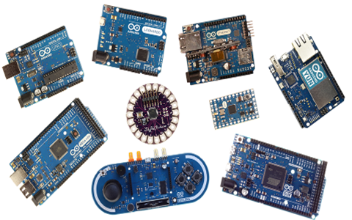
Types of Arduino
There are many types of Arduino boards available in the market but all the boards have one thing in common: they can be programmed using the Arduino IDE.

